Slide 1
ANALYTICAL REASONING
SHABANA

Slide 3



Three sisters – Anusha, Bhavya and Charu, work as an architect, a builder and a cook, not necessarily in the same order. They married Adam, Bob & Chris. For each of the 3 sisters the first letter of her name, the name
of her profession and the name of her husband are different. If Chris’s
wife is not a builder, then who is Bob’s wife?
a. Anusha b. Charu c. Bhavya d. CBD

Slide 4
Six friends A, B, C, D, E and F work In different companies namely Pentasoft, Quark, Raymond’s, Sunmet, Trump & Gates and Uzen
and each wears company sponsored different coloured shirts, viz, Blue, Green, Pink, Yellow, Purple and Red though not necessarily
in the same Order.
The one wearing the blue shirt works in Sunmet and the one
wearing green shirt works in Pentasoft. F does not work in
Raymond’s or Trump & Gates. A wears Pink shirt and works In
Quark. D does not work in Trump & Gates and purple coloured
shirt is Not sponsored by Raymond’s. E works in Uzen and neither D nor B works in Sunmet. Trump & Gates does not sponsor
purple or yellow coloured shirts and C works in Pentasoft.
1

Slide 5
INFERENCE
Which of the links is rightly matched?
a. F – Raymond – Purple b. D – Raymond – Red
c. F – Sunmet – Blue d. C – Pentasoft – Red
Which of the following is / are rightly matched?
i. A – Pink – Quarks ii. D – Blue – Raymond
iii. B – Red – Trump and Gates iv. E – Green – Uzen
a. i only b. i & II only
c. i & iii only d. i,ii & iii only
Which of the following are not correct?
a. C – Green – Pentasoft b. A – Pink – Quarks
c. E – Purple – Uzen d. B – Blue – Trump & Gates

Slide 6
Five friends Manish, Ashish, Rahul, Kapil and Pravin are musician, architect, doctor, engineer and artist by profession and live in
Lucknow, Mumbai, Kolkatta, Delhi and Pune but not in that order.
Pravin and Rahul do not live in Lucknow, or Pune and neither of
them is an architect or doctor. Manish and Ashish are not artist or engineering and they do not live in Delhi or Lucknow. Kapil is
neither a doctor nor a musician. The Person living in Lucknow is
neither an artist nor an engineer. Manish does not live in Kolkata
and Ashish is not a doctor. The musician does not live in Pune or Mumbai. Pravin is not an artist and the artist does not live in Delhi
2

Slide 7
INFERENCE
Who lives in Lucknow?
a) Ashish b) Kapil c) Manish d) Can’t say
Kapil is a/an _______
a) Musician b) Artist c) Architect d) Can’t say
Who is the artist?
a) Rahul b) Pravin c) Ashish d) Can’t say
The engineer who lives in delhi is
a) Kapil b) Pravin c) Rahul d) Manish
The musician lives in
a) Kolkata b) Delhi c) Lucknow d) Can’t say
The person living in Pune is
a) Ashish b) Pravin c) Manish d) Can’t say
The person living in Mumbai is
a) Architect b) Engineer c) Doctor d) Artist
Where does Pravin live?
a) Lucknow b) Delhi c) Mumbai d) Can’t say

Slide 8
There are six members in a family. Amrendra is the only male in
that family. One of the members is an engineer. A person came to
Amrendra’s home to gather some information related to census. When the census officer came in, he saw all the six members of
the family was taking their lunch around a table.
The census officer came to know that, the persons taking their
lunch are: the teacher, Sheela, Kamini, the author, the nurse and
Priti. Kamini is neither the doctor nor the professor. Neither
Amrendra nor Punam is the nurse. Amrendra is not the teacher.
When the census officer was to return, Sheela, Rita and the doctor wanted to go with him in his work.
3

Slide 9
INFERENCE
What is the Profession of the only male member in the group?
Doctor b) Professor c) Teacher d) Author
e) NOTA
Which of the following is the profession of Rita?
Doctor b) Professor c) Teacher d) Author
e) NOTA.
Who is an Engineer?
Amrendra b) Sheela c) Rita d) Punam
e) NOTA
Which of the following combinations is not correct?
a) Kamini – Engineer b) Punam – Teacher c) Priti – Nurse
d) Sheela – Professor e) Amrendra – Author.
Which of the following combinations is correct?
a) Sheela – Engineer b) Rita – Nurse c) Priti – Teacher
d) Punam – Professor e) Amrendra – Engineer.

Slide 10
Seven members P, Q, R, S, T, U and V are working in different cities –
Ahmedabad, Bangalore, Chennai, Hyderabad, Kolkata, Delhi and Mumbai
not necessarily in the same order. Each one a different mother tongue –
Tamil, Kannada, Telugu, Hindi, Marathi, Punjabi and Bangla – not
necessarily in the same order.
R works in Bangalore and his mother tongue is not Tamil or Marathi.
S's mother tongue is Punjabi and he works in Ahmedabad.
T and U do not work in Chennai and none of them has Marathi as their mother tongue.
Q works in Hyderabad and his mother tongue is Telugu.
The one who works in Delhi has Bangla as his mother tongue.
V works in Mumbai and his mother tongue is Hindi.
T does not work in Kolkata.
4

Slide 11
INFERENCE
What is R's mother tongue?
Telugu B. Hindi C. Bangla D. Kannada E. Tamil
Who works in Chennai?
P B. T C. U D.T or U E. None of the above
Which of the following combinations is correct?
A. Marathi -Q- Hyderabad B. Hindi-V- Delhi C. Marathi -Q- Chennai
D. Punjabi S – Delhi E. Tamil - U - Kolkata
Who works in Delhi?
A. P B. U C. T D. S E. V
What is U's mother tongue?
A. Bangla B. Marathi C. Telugu D. Hindi E. None of these

Slide 12
Eight members P, Q,R, S, T, U, V and W belonging to three families A, B, C go for weekend outing in three different cars Swift, Ritz, Zen. Four of
eight members are females. Members of any one family travel in different cars. Each car has at least one male and one female member. Each family
has at least two members.
P belongs to family B and he travels in car Zen. S is wife of T and they
travel in cars Swift and Ritz, respectively. W is son of Q who is wife of V
and they belong to family C. R is daughter of U who is wife of P. R travels in car Ritz. V does not travel with U.
5

Slide 13
INFERENCE
Which of the following group of persons to travel in car Swift?
A. S, U, W B. S, T, V C.S. V D. S, U E. None of these
Which car has only two members travelling in it?
A. Swift B. Ritz C. Zen D. Ritz or Zen E. Swift or Ritz
Which of the following members of families B and C travel in different cars?
U, V B. R, V C. U, W D. R, U E. None of these
Which of the following group of persons is a group of all females?
A. Q. S, V B. P, Q, R C. Q, T, U D. R, S, T E. None of these
Which of the following members of families A and B travel in the same car?
A. R, U B. S, U C. R, S D. U, V E. None of these

Slide 14
During the school silver jubilee, four alumni were discussing their starting annual
salaries back in 1981. The salaries in question were Rs. 40,000, Rs. 50,000,
Rs. 60,000 and Rs. 70,000 per year. Of course the present MD of a private
company earned the most. Arvind earned more than Biswajit and the doctor
earned more than Dhruv, the engineer. Chinmayee could not remember what he
started on and Biswajit, the lawyer didn’t start on Rs. 50,000 nor did Dhruv.
What is Chinmayee’s current profession?
What was the lawyer’s starting salary?
Who received highest starting salary?
5

Slide 15
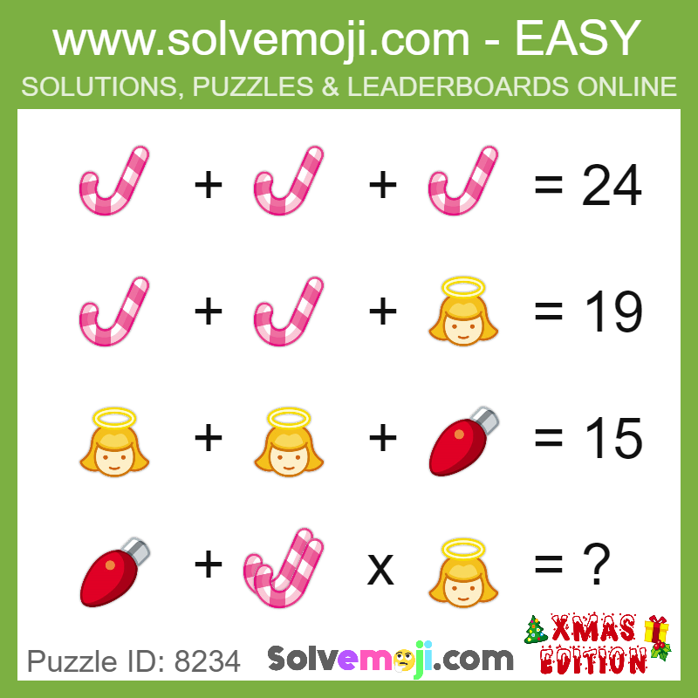

Slide 16
THANK YOU

